Slide 1
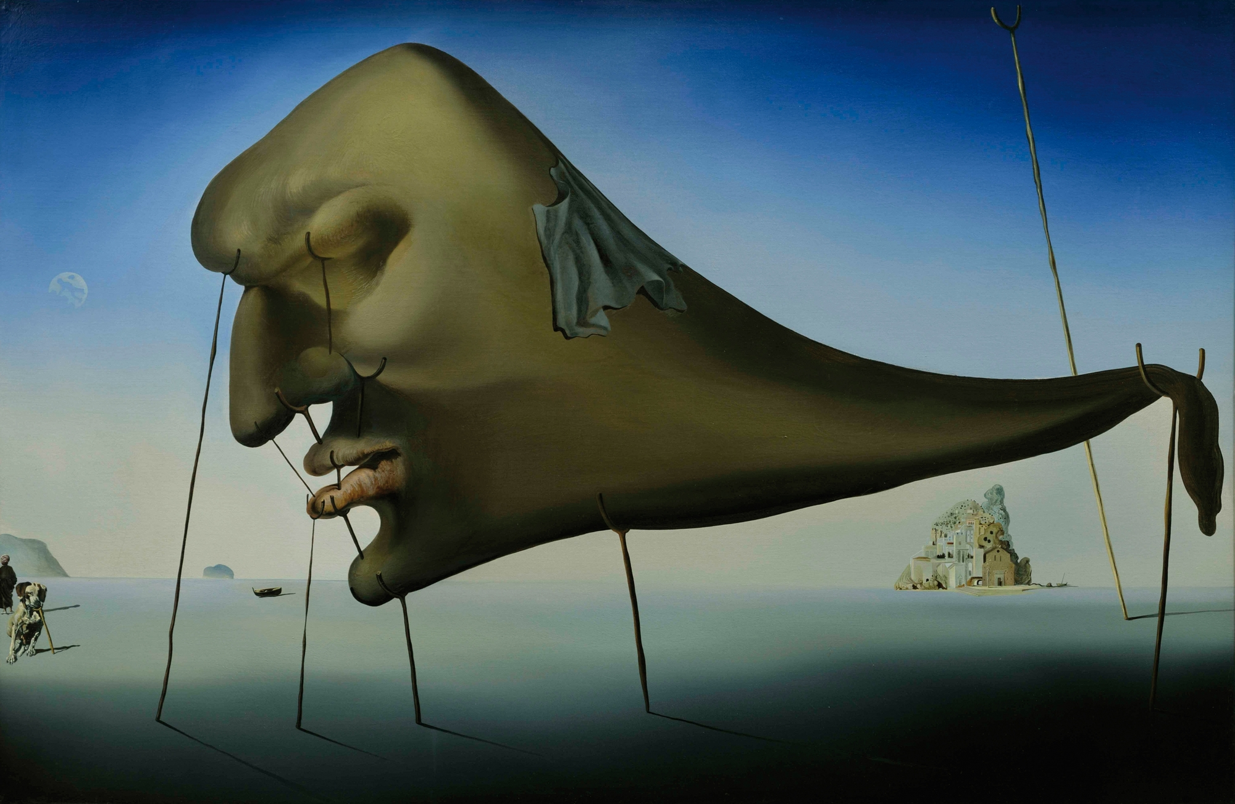
Surrealism
Surrealism – What Is That? | Tate Kids

Slide 2
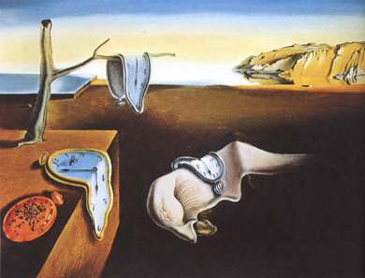
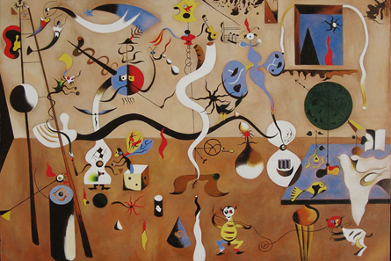
Different Types of Surrealism
Inspired by dreams Inspired by subconscious and memories
The Persistence of Memory - Salvador Dali, 1931. The Harlequin’s Carnival - Joan Miro, 1925.

Slide 3
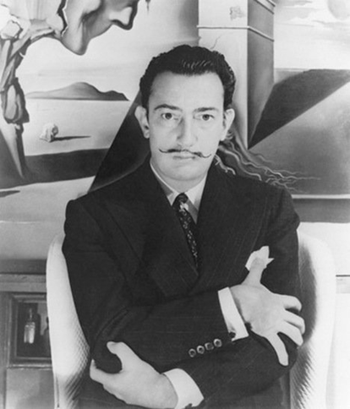
Salvador Dali
Dalí was born in 1904 in Figueres, Spain.
Salvador Dalí made paintings, sculptures and films about the dreams he had. They were very abstract & strange.

Slide 4
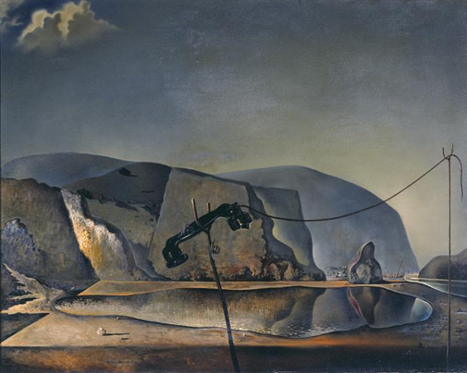
Mountain Lake - Salvador Dalí, 1938

Slide 5
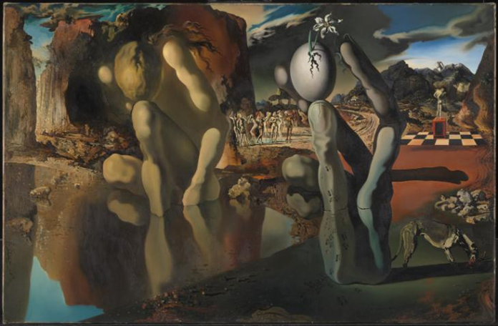
Metamorphosis of Narcissus - Salvador Dalí, 1937

Slide 6
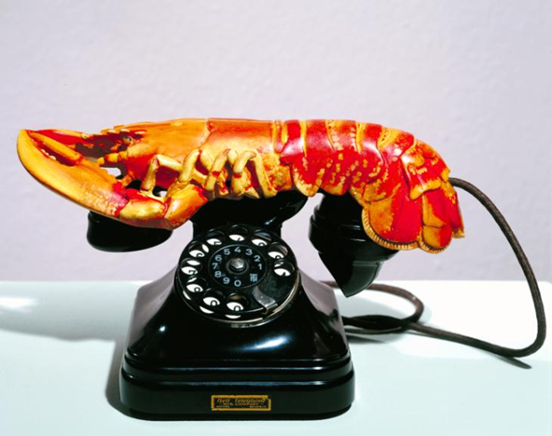
Lobster Telephone - Salvador Dalí, 1936

Slide 7
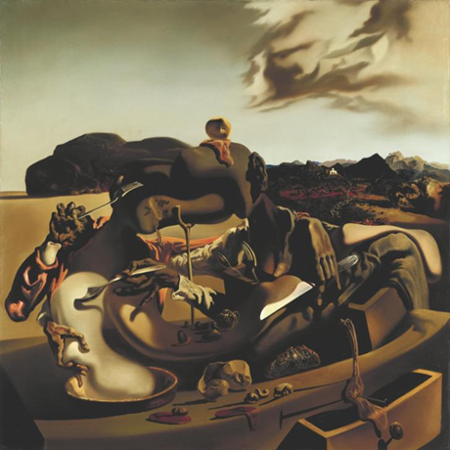
Autumnal Cannibalism - Salvador Dalí, 1936

Slide 8
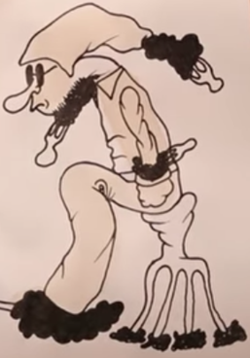
What kind of surrealist art are we creating?
Coffee Drawings

Slide 9
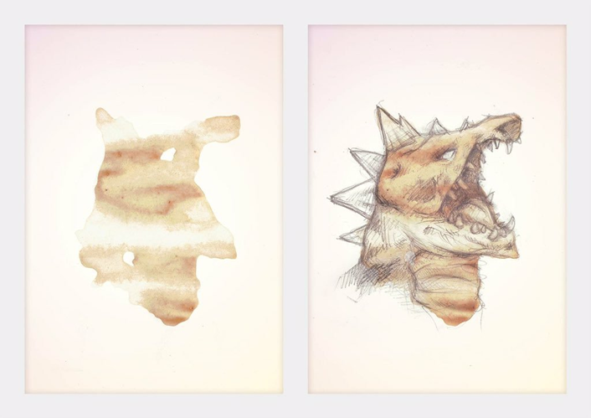
Coffee
Stain
Art
How to draw on COFFEE STAINS!!! Episode 4 - YouTube

Slide 10
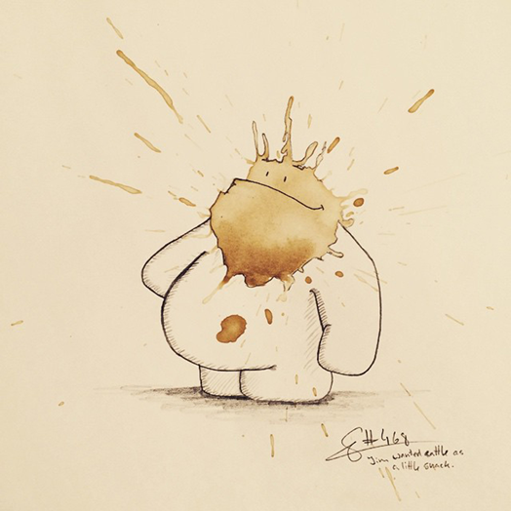
Coffee
Stain
Art

Slide 11
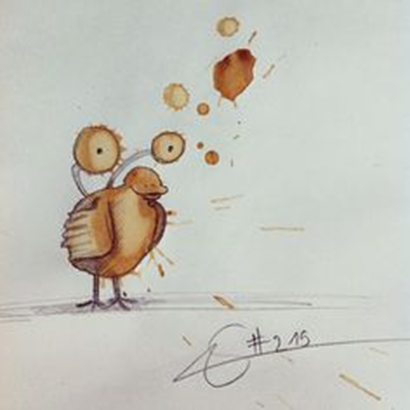
Coffee
Stain
Art

Slide 12
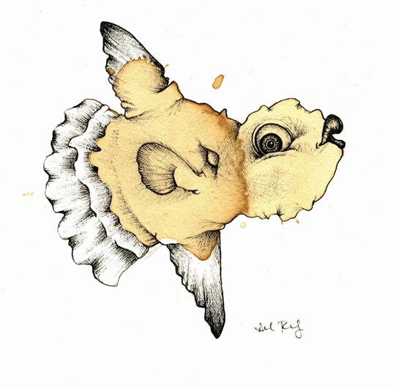
Coffee
Stain
Art

Slide 13
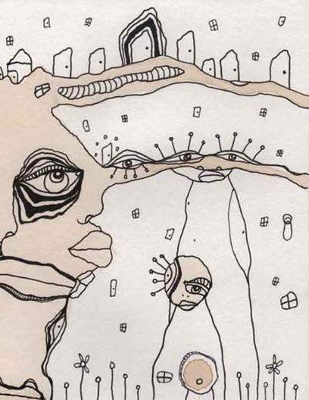
Coffee
Stain
Art

Slide 14
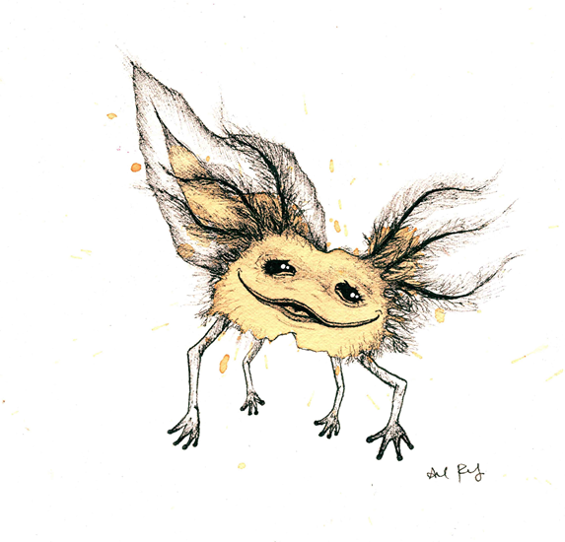
Coffee
Stain
Art

Slide 15
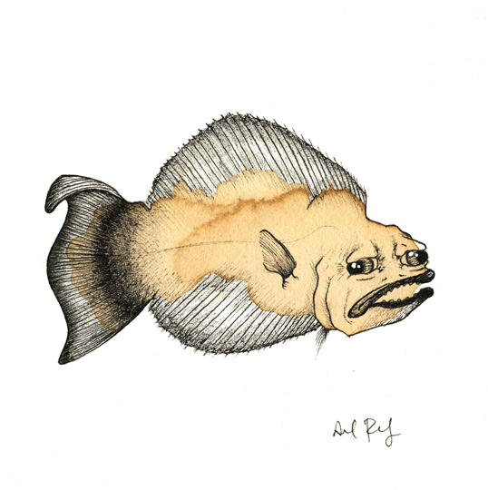
Coffee
Stain
Art

