Slide 1
Creating Comic
Strips

Slide 2
Step 2:
Brainstorm
Step 1:
Create Characters
Step 4:
Review /
Edit
Step 3:
Write & Draw

Slide 3
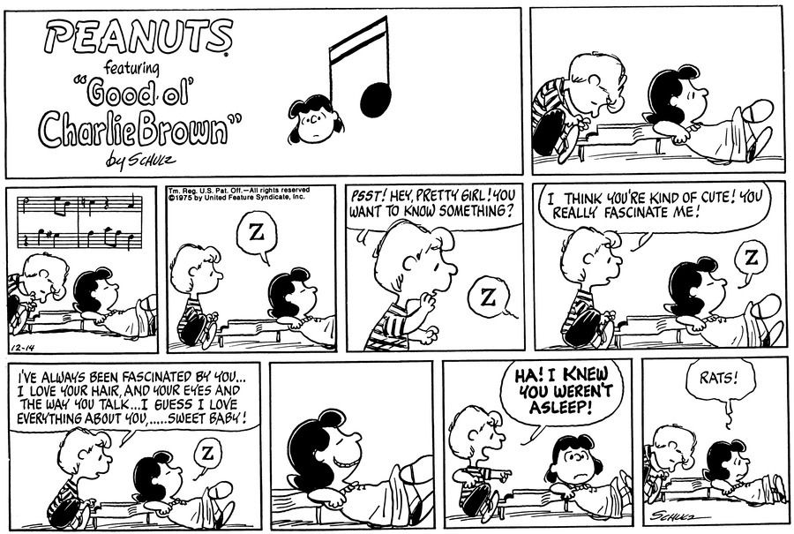

Slide 4
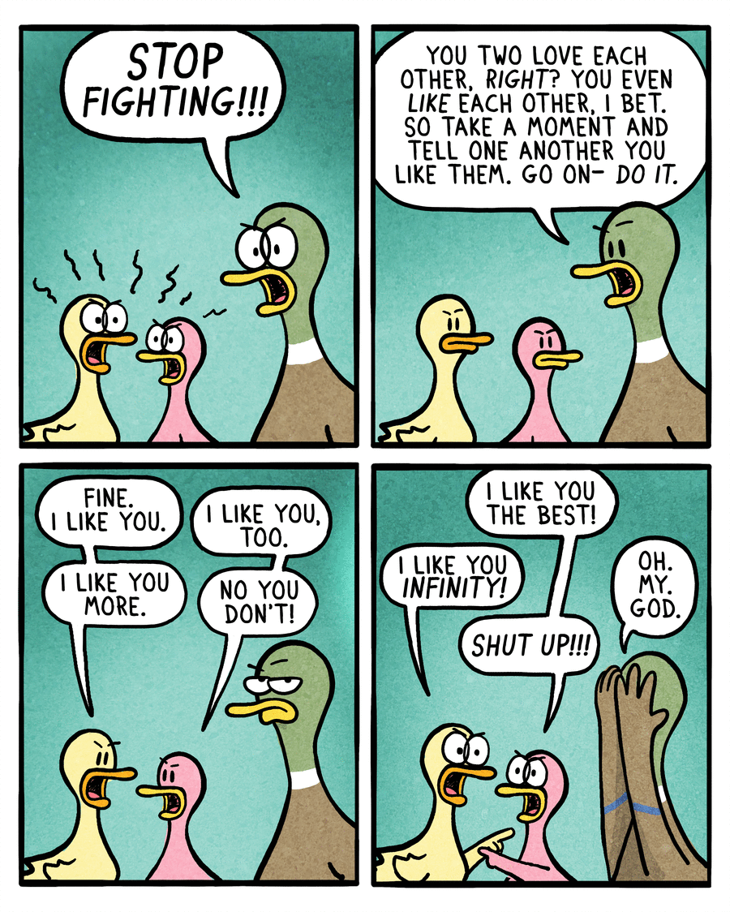

Slide 5
